Slide 1
DSM 5 Equivalents of Current Psychocutaneous diseases
Ladan Mostaghimi, MD
Clinical Professor
UW Madison
2018 APMNA meeting

Slide 2
Conflict of interest
I do not have any conflict of interest for this presentation

Slide 3
Goals
Integration of DSM 5 in dermatology literature.
Discussing DSM 5 equivalents of different Psychocutaneous entities.

Slide 4
Why do we need to integrate?
If we consider body and mind as one, in order to have an integrative approach to patient care and research we need a common language between physicians of different specialties.
Currently dermatology and psychiatry use different language and diagnostic criteria to discuss the same diseases.
We need a common language to make interdisciplinary work more accessible.
Knowing the psychiatry language gives dermatologist better understanding for treatment:
For example: if the symptoms are related to delusional disorders the treatment is very different comparing to when symptoms are due to anxiety.

Slide 5
Current classifications:
Dr. Koo’s classification:
is based on 5 categories of interface between psychiatry and dermatology:
1- Psychophysiological disorders: such as psoriasis
2-Primary psychiatric disorders: such as delusions of parasitosis, BDD.
3-Secondary psychiatric disorders: Chronic skin disease causing emotional problems.
4-Cutaneous sensory disorders: such as pruritus
5- Use of psychotropic medications for dermatological conditions.

Slide 6
Alternative classification
Classify the Psychocutaneous conditions based on the underlying psychopathology such as depression, anxiety, OCD….
This is a more practical approach since psychiatry literature has research and diagnostic tools available for uniform diagnosis and treatment.

Slide 7
DSM 5 Equivalents of Psychocutaneous diseases:
The term delusional disorder somatic type in DSM 5:
includes a central theme of bodily sensations or functions:
-in order to meet the criteria the delusions should last 1 month or longer and should not meet the criteria for Schizophrenia.
-if hallucinations are present they are related to the delusions and are not prominent.
-patients’ function is not markedly impaired except for impact of the delusions.
-patients’ do not have other mental disorders, physical conditions or substance abuse that could explain their symptoms.

Slide 8
Delusional disorder somatic type equivalents in dermatology:
Delusions of parasitosis,
Ekboms syndrome,
Delusional parasitosis,
Psychogenic parasitosis,
Pseudoparasitic dysaesthesia,
Delusional infestation,
Parasitic dermatophobia,
Parasitophobia,
Entomophobia,
acarophobia

Slide 9
DSM 5: Factitious disorder imposed on self
Criteria:
Falsification of physical or psychological symptoms associated with deception.
The individuals present themselves to others as ill
The illness behavior is present in the absence of obvious secondary gain (as opposed to malingering).
The behavior is not better accounted by other physical, mental disorder or substance abuse.
Identifier: single episode or recurrent episode.
-DSM 5 also identifies: Factitious disorder imposed on another (previously factitious disorder by proxy), in which case deception and falsification is by individual on another victim.

Slide 10
Dermatology terms used to explain Factitious disorder imposed on self:
Dermatitis artefacta,
Factitious dermatitis,
Self-induced factitial dermatitis,
Dermatitis factitia,
Artefactual skin disease,
Factitious illness,
Illness falcification,
Dermatology pathomimicry,
Cutaneous artefactual disease,
Dermatitis simulate,
Factitious skin disease.

Slide 11
Excoriation (Skin-Picking) disorder:
This term is newly adopted in DSM 5. It was under general impulse control disorders in DSM IV.
Criteria:
Recurrent skin picking causes skin lesions.
Repeated attempts to stop or decrease picking
Picking causes clinically significant distress or impairment in social, occupational, or other areas of functioning.
Picking is not better accounted by other medical condition or substance use or mental disorder such as picking due to somatic delusions, BDD, stereotypical movement d/o, non suicidal self-injury.

Slide 12
Dermatology equivalents of Excoriation disorder:
Dermatillomania,
Psychogenic excoriation,
Compulsive skin picking,
Pathological skin picking,
Skin picking disorder,
Dermatitis para-artefacta,
Self injurious skin picking,
Repetitive skin picking,

Slide 13
Dermatology equivalents of Excoriation disorder continue:
Emotional Excoriations,
Nervous scratching artefacta,
Para-artificial excoriation,
Epidermatillomania,
Acne Urticaria.

Slide 14
Dermatology equivalents of Excoriation disorder continue
If the picking is in other areas of body the following names are used in dermatology literature:
Rhinotillexomania (pathological nose picking or compulsive nose picking)
Onychotillomania (pathological nail biting).
Self-inflicted cheilitis or cheilitis artefacta, factitious cheilitis, factitious lip crusting (for picking at lips).
Morsicatio Buccarum (due to repeated sucking and chewing of oral mucosa)

Slide 15
Prurigo nodularis and Lichen Simplex Chronicus
These problems are both due to chronic itch/scratch/rub of the skin.
The cause of itch needs to be investigated.
If no reason is found they can be classified under skin picking disorder.

Slide 16
Trichotillomania
In DSM 5 Trichotillomania is classified under the group of:
Obsessive Compulsive and related disorders:
The reason for this grouping is the common threads between OCD and repetitive behaviors.
Other dermatology names: Trichotemnomania, Trichotieromania

Slide 17
Trichophagia (Trichorrhizophagia) and Onychophagia
When patients excessively eat the roots of hair or bite and swallow nails.
Skin pickers also could chew and eat on scabs.
Under DSM5 these disorders would be under:
Feeding and Eating disorder under term of Pica:
This means persistent eating of nonnutritive, nonfood substances over a month period.
The habit is inappropriate for developmental level and culture.
It is not part of another mental disorder such as autism.

Slide 18
Cutaneous sensory disorder: Pain and Itch in dermatology
Chronic abnormal skin or mucosal sensations such as burning mouth syndrome or Vulvodynia.
Under DSM 5 the term “Somatic symptoms disorder” is used.
If the symptoms are causing distress and disruption of daily life associated with one of the following (Criterion B):
Disproportionate and Persistent thoughts about the seriousness of symptoms.
High and persistent levels of anxiety about symptoms.
Excessive time and energy devoted to the symptoms and health concerns
Problems usually last longer than 6 months.

Slide 19
Somatic symptoms disorder
If pain is the main symptom the specifier “with predominant pain” is used.
The specifier “persistent” is used if the symptoms last more than 6 months.
The “severity” specifier is also used to mark current severity: Mild is having one of the Criterion B sxs, Moderate is for 2 or more of criterion B, and Severe for 2 or more criterion B, or multiple somatic symptoms or one very severe symptom.

Slide 20
What if the full criteria is not met?
If the full criteria is not met the term: Other specified somatic symptom and related disorders is used.
When there is insufficient information to make a more specific diagnosis: Unspecified somatic symptoms and related disorder is used.

Slide 21
Body Dysmorphic Disorder (BDD)
In DSM 5 BDD is classified under OCD and related disorders:
Diagnosis criteria:
Preoccupation with one or more perceived defects or flaws in physical appearance that are either slight or not observed by others.
Repetitive behaviors such as mirror checking, excessive grooming, skin picking, reassurance seeking, or mental acts (comparing self to others) in response to concerns.
The preoccupation causes clinically significant distress and impairment and is not better accounted by other mental disorders such as eating disorder (concern about body fat).

Slide 22
BDD specifiers
With muscle dysmorphia.
With good or fair insight, poor insight, or with absent insight/delusional beliefs.

Slide 23
DSM 5: Mood disorders:
Depressive disorder due to another medical condition (Include the name of the other medical condition):
A prominent and persistent period of depressed mood, or markedly diminished interest or pleasure in all, or almost all activities.
There is evidence based on history, clinical exam, laboratory findings that the disturbance is direct pathophysiological consequence of another medical condition
The disturbance is not better accounted by another mental disorder such as Adjustment d/o with depressed mood with the stressor being a serious medical condition.
It does not occur exclusively during the course of delirium.
Causes clinically significant distress or impairment in social, occupational, or other important areas of functioning.
Specify if: with depressive features, with major depressive-like episode, or with mixed features with sxs of mania and hypomania also present but do not predominate.

Slide 24
Mood disorders:
Anxiety Disorder Due to Another Medical Condition (include name of the medical condition).
Panic attacks or anxiety predominates the clinical picture.
There is evidence from the history, physical examination, or laboratory findings that the disturbance is the direct pathophysiological consequence of another medical condition.
The disturbance is not better accounted by another medical condition.
Does not occur exclusively in the course of delirium.
The disturbance causes clinically significant distress or impairment in social, occupational, or other important areas of functioning.

Slide 25
Mood disorders:
Bipolar and Related Disorders Due to Another Medical Condition (add the name of the medical condition)
A prominent or persistent period of abnormally elevated, expansive, or irritable mood and abnormally increased activity or energy predominates clinical picture.
There is evidence from the history, clinical exam, or laboratory findings that the disturbance is the direct pathophysiological consequence of another medical condition.
The disturbance is not better accounted by another mental disorder.
The disturbance does not occur exclusively during the course of delirium.
It causes clinically significant disturbance (social, occupational, or other important areas of functioning) or needs hospitalization to prevent harm to self or others, or there are psychotic features.

Slide 26
Mood disorders:
Bipolar and Related disorder due to another medical condition:
Specify if:
-with manic features: The criteria are not met for manic episode.
- with manic or hypomanic-like episode: The criteria are met
-with mixed features: symptoms of depression are also present but do not predominate.

Slide 27
Substance/Medication induced Mood and Anxiety disorders
Medications used in dermatology could cause mood and anxiety disorders, Steroids and Accutane are prime examples.

Slide 28
Illness Anxiety Disorder
Preoccupation with having or acquiring a serious illness.
Somatic symptoms are not present or, if present are mild in intensity
If another medical condition is present or there is higher risk of a medical condition due to family history the preoccupation is clearly excessive or disproportionate.
There is high level of anxiety about health and the individual is easily alarmed about personal health status.
The individual performs excessive health-related behaviors or maladaptive avoidance (avoids doctor appointments or going to hospitals)
The illness preoccupation has been present for at least 6 months, but the specific illness that is feared may change over time.

Slide 29
Illness Anxiety disorder:
The illness related preoccupation is not better accounted by another mental disorder
Specify if:
Care-seeking type
Care avoiding type
Always check with patients how anxious they are with their skin problem and what they expect that will happen due to symptoms?

Slide 30
References:
1. Ring HC, Smith MN, Jemec GB. Self-inflicted skin lesions: a review of the terminology. Acta Dermatovenerol Croat. 2014;22(2):85-90.
2. Gieler U, Consoli SG, Tomas-Aragones L, et al. Self-inflicted lesions in dermatology: terminology and classification--a position paper from the European Society for Dermatology and Psychiatry (ESDaP). Acta Derm Venereol. 2013;93(1):4-12.
3. American Psychiatric Association., American Psychiatric Association. DSM-5 Task Force. Diagnostic and statistical manual of mental disorders : DSM-5. Fifth edition. ed. Arlington, VA: American Psychiatric Association; 2013.

Slide 31
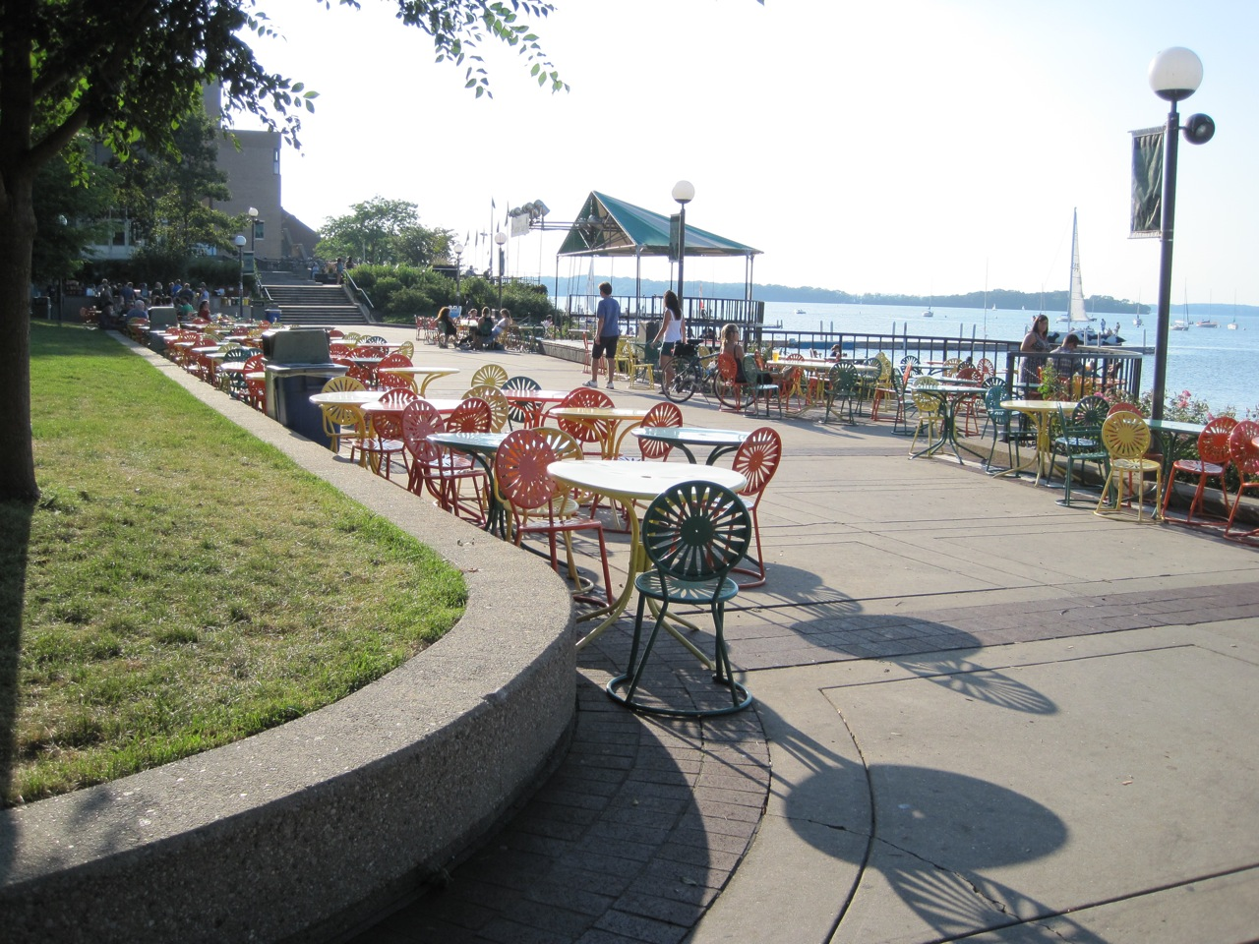
Thank You
Special thanks to Dr. Francisco Tausk
My new email:
lmostaghimi@mind-skin.com

